Slide 1
tinyurl.com/ hackhyland2023
Everything you need to know for the Hackathon, all in one place!

Slide 2
Sunday Schedule
8:30-10:30AM | Grab-n-Go Breakfast | Hallway
11:30PM-12:30PM | Workshop: Presenting 🖌️ | Auditorium
12:30-1:30PM | Lunch | Hallway
3:00PM | + Code Cut Off + | Workstations
3:30PM | Judging Begins | Auditorium
6-6:30PM | Dinner | Auditorium
6:30-7PM | + Closing Ceremony + | Auditorium
Full schedule available at tinyurl.com/hackhyland2023

Slide 3
Strive for Greatness
tinyurl.com/hackhyland2023

Slide 4
Earn Raffle Tickets
⚒
Attend Workshops
😇
Be Nice
❔
💪
Ask Good Questions
Work Hard
🎴
Help Others
WIN PRIZES
tinyurl.com/hackhyland2023

Slide 5
Shoot for the Stars
tinyurl.com/
hackhyland2023

Slide 6
Hold up!
Have to leave the building? Make sure you sign out with a mentor before you depart.
More information at tinyurl.com/hackhyland2023

Slide 7

Contact
Discord
Phone
Email
Reach mentors and facilitators online
Caitlin: (216) 469-4921
Marissa: (216) 314-7660
Joseph: (216) 218-2609
Visit the Mentor Room
Send a message to techoutreach@hyland.com
More information at tinyurl.com/hackhyland2023

Slide 8
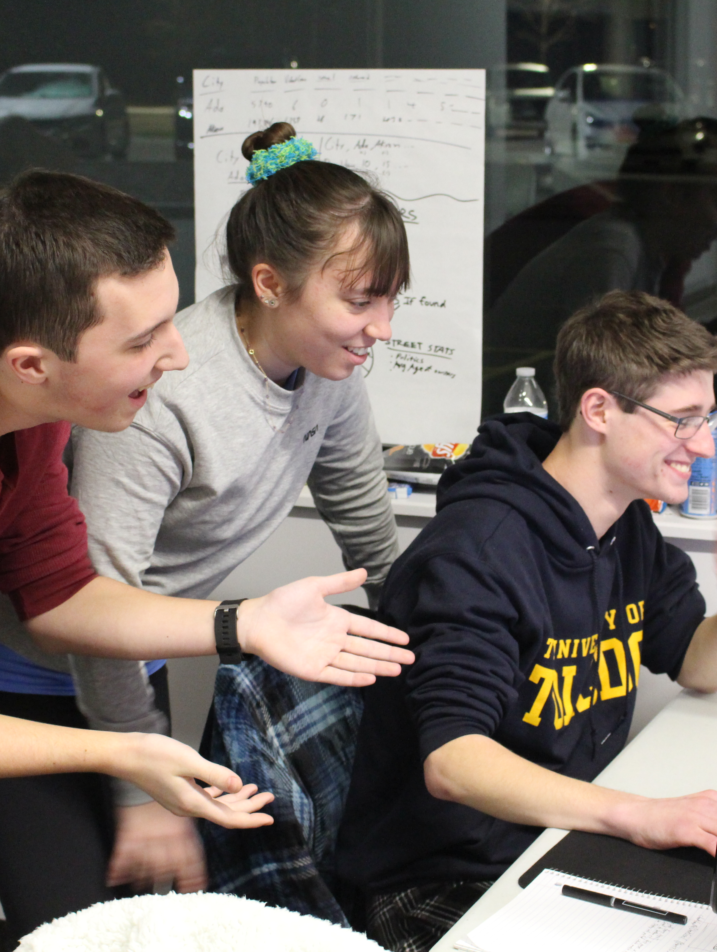
Photos & Posts
Share your Hackathon experience with the world
Use #HylandHackathon on your posts for a chance to be featured on Hyland social media 😎
tinyurl.com/hackhyland2023

Slide 9
Believe in Yourself
tinyurl.com/hackhyland2023

